Slide 1
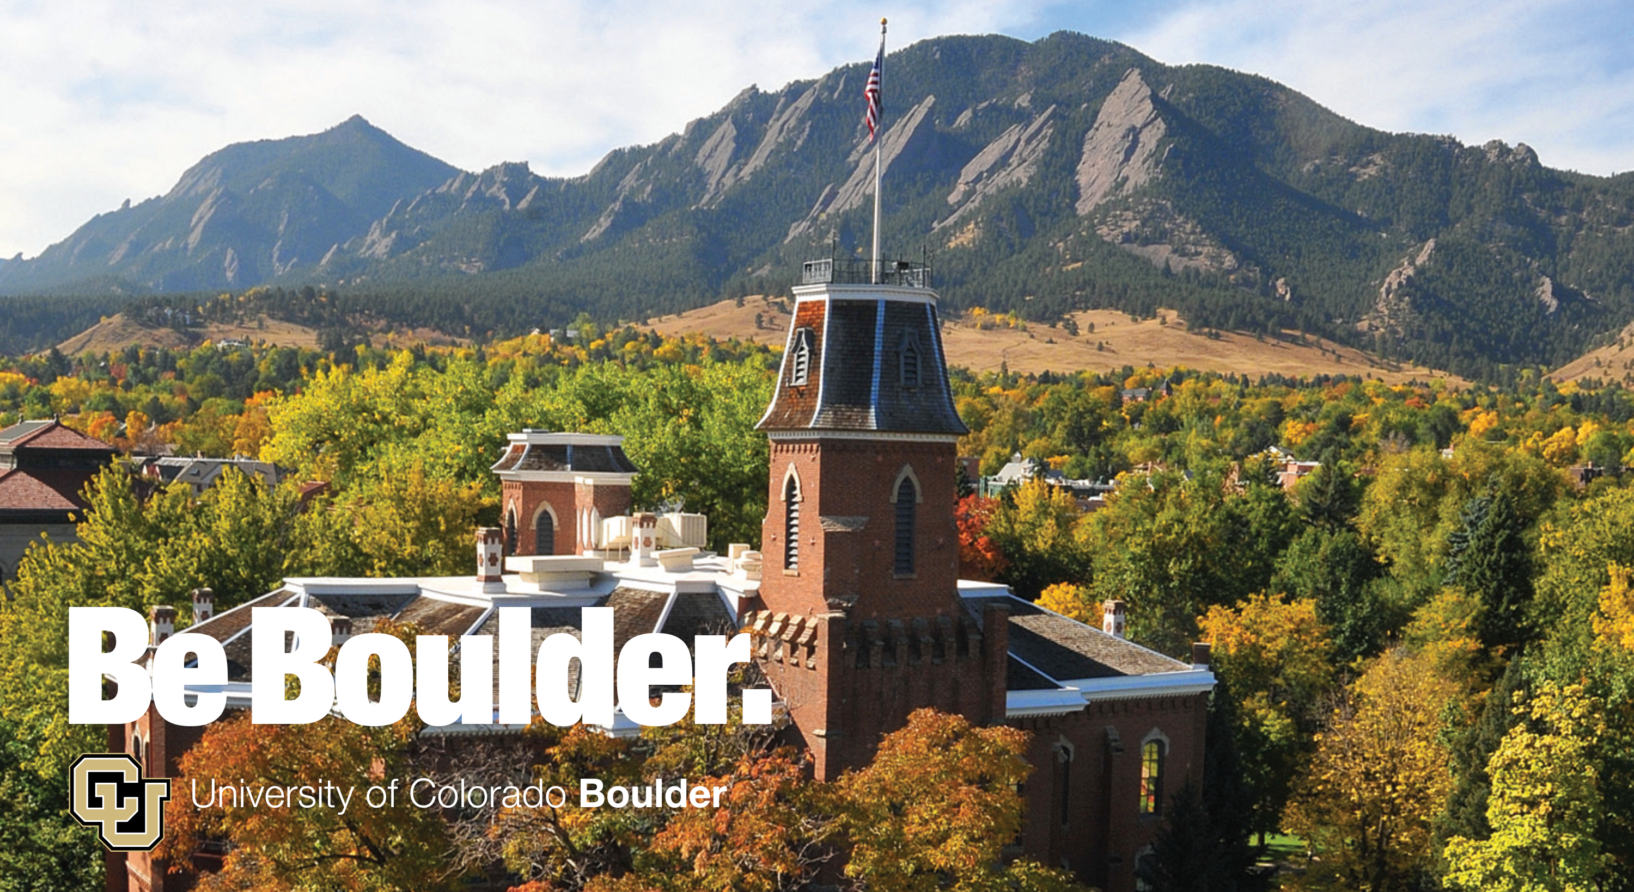
So you’re thinking about coding?
Andrew Monaghan, Research Computing and CRDDS,
Katie Mika, University Libraries and CRDDS,
University of Colorado Boulder

Slide 2
What is coding?
Coding is the process of encoding instructions for execution by a computer. Coding results in software.
Coding is synonymous with programming.
Coding is done in a variety of programming languages.

Slide 3
Who codes, and why?
Everyone! For example:
Historians mining ancient texts.
Psychologists simulating human behavior.
Political scientists studying voting patterns.
Chemists designing new compounds.
Biologists deciphering animal or plant genomes.
Neuroscientists exploring brain function.
Engineers designing nanomaterials.
Geologists simulating earthquakes.
Meteorologists modeling climate.

Slide 4
Programming languages: The 5 generations
1GL: Machine language
2GL: Assembly language
3GL: Imperative language
4GL: Declarative language
5GL: Natural language
Nearly all of the coding we presently do falls into these two categories
https://en.wikipedia.org/wiki/Programming_language

Slide 5
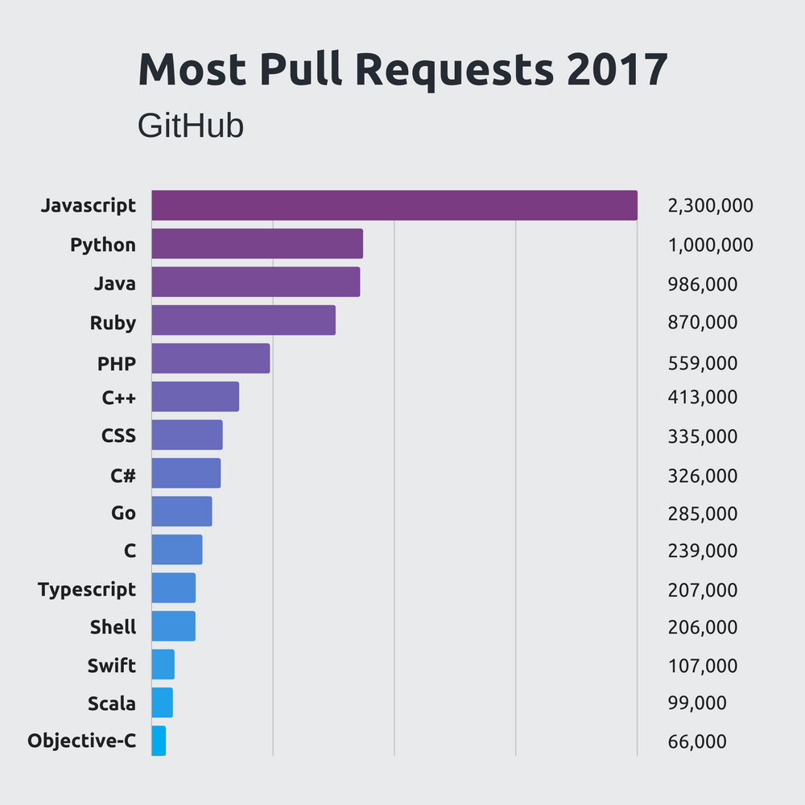
Most used languages, all categories
https://octoverse.github.com/

Slide 6
Most used languages, data science
http://bigdata-madesimple.com

Slide 7
Some commonly used languages in the sciences
Fortran, C, C++ (“compiled languages”)
R, Python, Perl, Java, Matlab (“interpreted languages”)
Bash, C-shell (shell languages)

Slide 8
Some common aspects of all languages
Variables
Arithmetic expansion
Decisions
Loops
Arguments
Functions
…Examples of each follow using the Bash shell language.

Slide 9
Common aspect #1: Variables
A variable can contain a number, a character, a string of characters.
Variables enable commonly used values to be recorded only once.
Variables enable arrays of data to be represented more easily.
Variables enable values that change frequently to be coded only once.
$ PI=3.14159
$ name=(Andy Monaghan)
$ echo "${name[0]} loves $PI”
$ Andy loves 3.14159

Slide 10
Common aspect #2: Arithmetic Expansion
Arithmetic expansion provides a mechanism for evaluating an arithmetic expression and substituting its value. For example:
$ sqr_two=$(( 2 * 2 ))
$ echo ${sqr_two}
$ 4

Slide 11
Common aspect #3: Decisions
Decisions enable conditional expressions to be evaluated.
The if statement is the most common. For example:
x=$(date +%M) #query minutes after the hour
if [ $x -gt 30 ] ; then
echo "last half of the hour"
elif [ $x -lt 15 ] ; then
echo "first quarter of the hour"
else
echo "we're at ${x}"
fi

Slide 12
Common aspect #4: Loops
Loops enable operations to be done on arrays of data. For example:
list=”a b c”
for v in ${list} ; do
echo $v
done

Slide 13
Common aspect #5: Arguments
Arguments allow variables to be passed into programs. For example:
----- start program calcsine.sh ---
#!/bin/bash
# Calculate the sine of the argument.
sine=$(echo "s($1)" | bc -l )
echo "The sine of $1 is ${sine}"
----- end program ------
Now run the program with an argument:
> bash calcsine.sh 3.2
The sine of 3.2 is -.05837414342757990913

Slide 14
Common aspect #6: Functions
Functions enable repetitive operations to be coded once and then reused. For example:
----start program-----
#!/bin/bash
#create a function that echoes back the input
gimme () {
echo $1
}
#now test
gimme Hello
gimme World

Slide 15
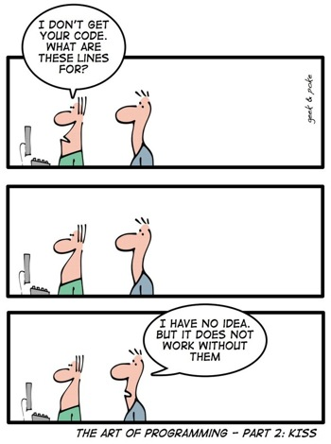
Coding best practices
Make a plan (write out beforehand)
Document code (comments, README)
Styling (group, indent, capitalize)
Use functions where possible
Avoid ‘hardcoding’ (use variables)
Version control (Github)

Slide 16
Programming with Python
Python is an interpreted language*.
Wide range of uses, considered “general purpose”.
It is open source, intuitive and has thousands of packages.
Development environments: Jupyter, console, etc.
Let’s do a Mini tutorial: Using Python for human language interpretation

Slide 17
Programming with R
R is an interpreted language*.
Particularly useful for statistical analysis and data analytics.
It is open source and has thousands of packages.
Development Environments: Rstudio, Jupyter, console, etc.
Let’s do a Mini tutorial: Using R to create and plot a simple model in Rstudio

Slide 18
Scaling up your workflow
Sometimes your laptop doesn’t cut it. For example:
You need to process thousands of images.
You want to analyze millions of pages of text.
You want to do machine learning to train a robot.
You want to discover genes associated with a disease.
You want to run a climate model.
…you’re in luck! We have a FREE supercomputer at CU!
Porting code from your laptop isn’t hard, and we can help.
See http://rc.colorado.edu/ for details

Slide 19
Resources for further learning (1)
We offer courses!
Coding in R workshop series (Wednesdays 4p-6p., Feb 6-Apr 3)
Introduction to Python series (Tuesdays 9a-10:30a., Feb 26-Apr23)
Introduction to Bash (3p-5p, Monday Feb 11)
….and more!
See https://www.colorado.edu/crdds/events & https://www.colorado.edu/rc/events

Slide 20
Resources for further learning (2)
Personalized help:
Interdisciplinary Data Consult Hours (Tue 12p-2p, Norlin E206)
LISA Statistics Walk-in Hours (Tue & Thur 12p-2p, Norlin E206)
Supercomputing consultations (email rc-help@colorado.edu)
Online software training: https://software-carpentry.org/lessons/

Slide 21
Questions?
Participant Feedback Survey:
http://tinyurl.com/curc-survey18
Slides and examples from this presentation:
https://github.com/ResearchComputing/coding_intro_spring_2019

